Slide 1
Mathematics of Trust
Alexander Stannat
Master Student
Applied Mathematics

Slide 2
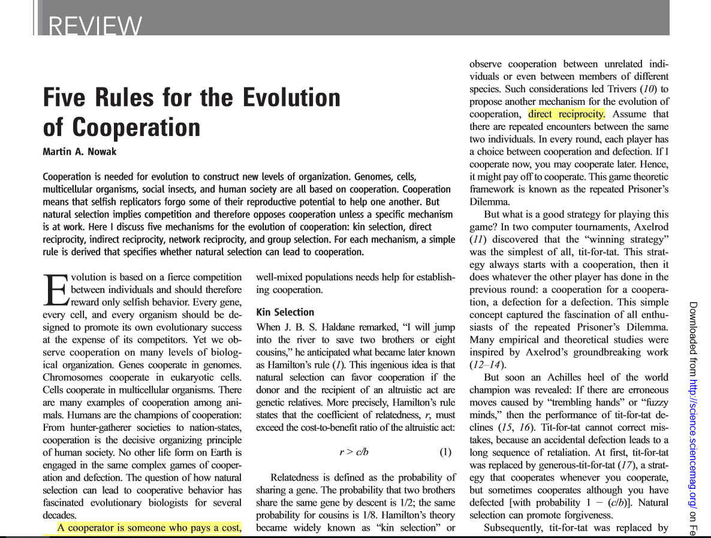

Slide 3
Direct vs Indirect Reciprocity
Direct Reciprocity: Tit-for-tat
Relies on repeated encounters between the same people
Prisoner’s Dilemma
Defecting more beneficial than cooperation
Indirect Reciprocity
Interactions are asymmetric and fleeting
Reputation fuels cooperation

Slide 4
How to implement a Mechanism for Trust
Design Goal: An algorithm, ranking agents based on their reputability in the network
How? Google‘s PageRank !

Slide 5
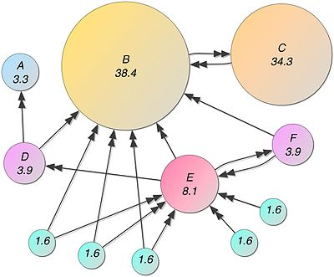
The PageRank Algorithm
Designed to rank webpages based on their importance
Importance Reputability

Slide 6

Mathematics of PageRank
PageRank is recursively determined by
with

Slide 7
Current Implementation
Approximate the PageRanks
Monte Carlo method
Simulate a large number of random walks
The PageRank of a node is determined by the times it is visited by the random walks

Slide 8
Random Walks in Action

Slide 9
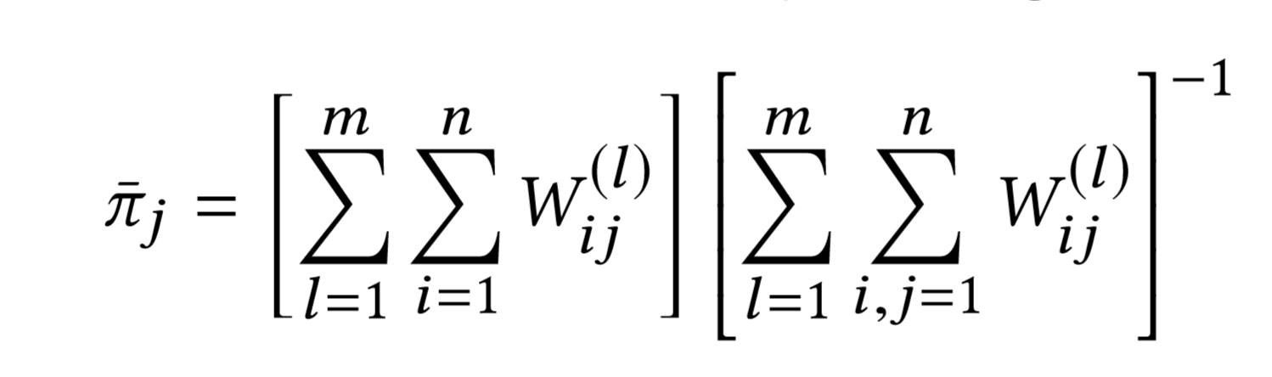

Mathematics of Monte Carlo
We run a random walk ${\left(X_{t}\right)}_{t≥0}, m$ times with average length $\frac{1}{c}.$
Let $W_{ij}$ denote the times $i$ is visited from $j$, then the PageRank is given by

Slide 10
Our Requirements
Personalisation: Trust is personal
Locality: Trust is transitive*
Incrementality: Trust is dynamic
* but not too much

Slide 11
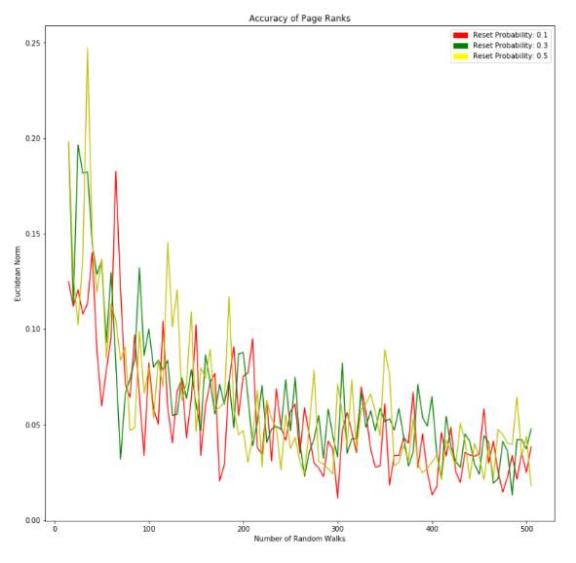
Implementation
667124 Blocks (289 Nodes)
Initial Computation: 14.2 seconds
Incremental Update: 5.1 seconds
Error
Number of random walks

Slide 12
Implementation
667124 Blocks (289 Nodes)
Initial Computation: 14.2 seconds
Incremental Update: 5.1 seconds
The number of Random Walks is crucial for accuracy!
Accuracy
Number of random walks

Slide 13
Sybil Attacks
What‘s stopping someone from creating many accounts and faking transactions?
Answer: Personalisation & Locality!
Due to personalisation global attacks are not profitable
Large Sybil regions are not profitable due to locality

Slide 14
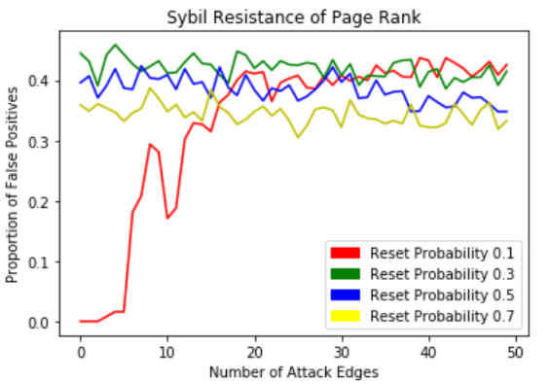

Slide 15
Conclusion
Effective method of measuring trust at a relatively low cost
Sybil resistance needs to be improved
No single mechanism can do this
Multiple lines of defense!

